Slide 1

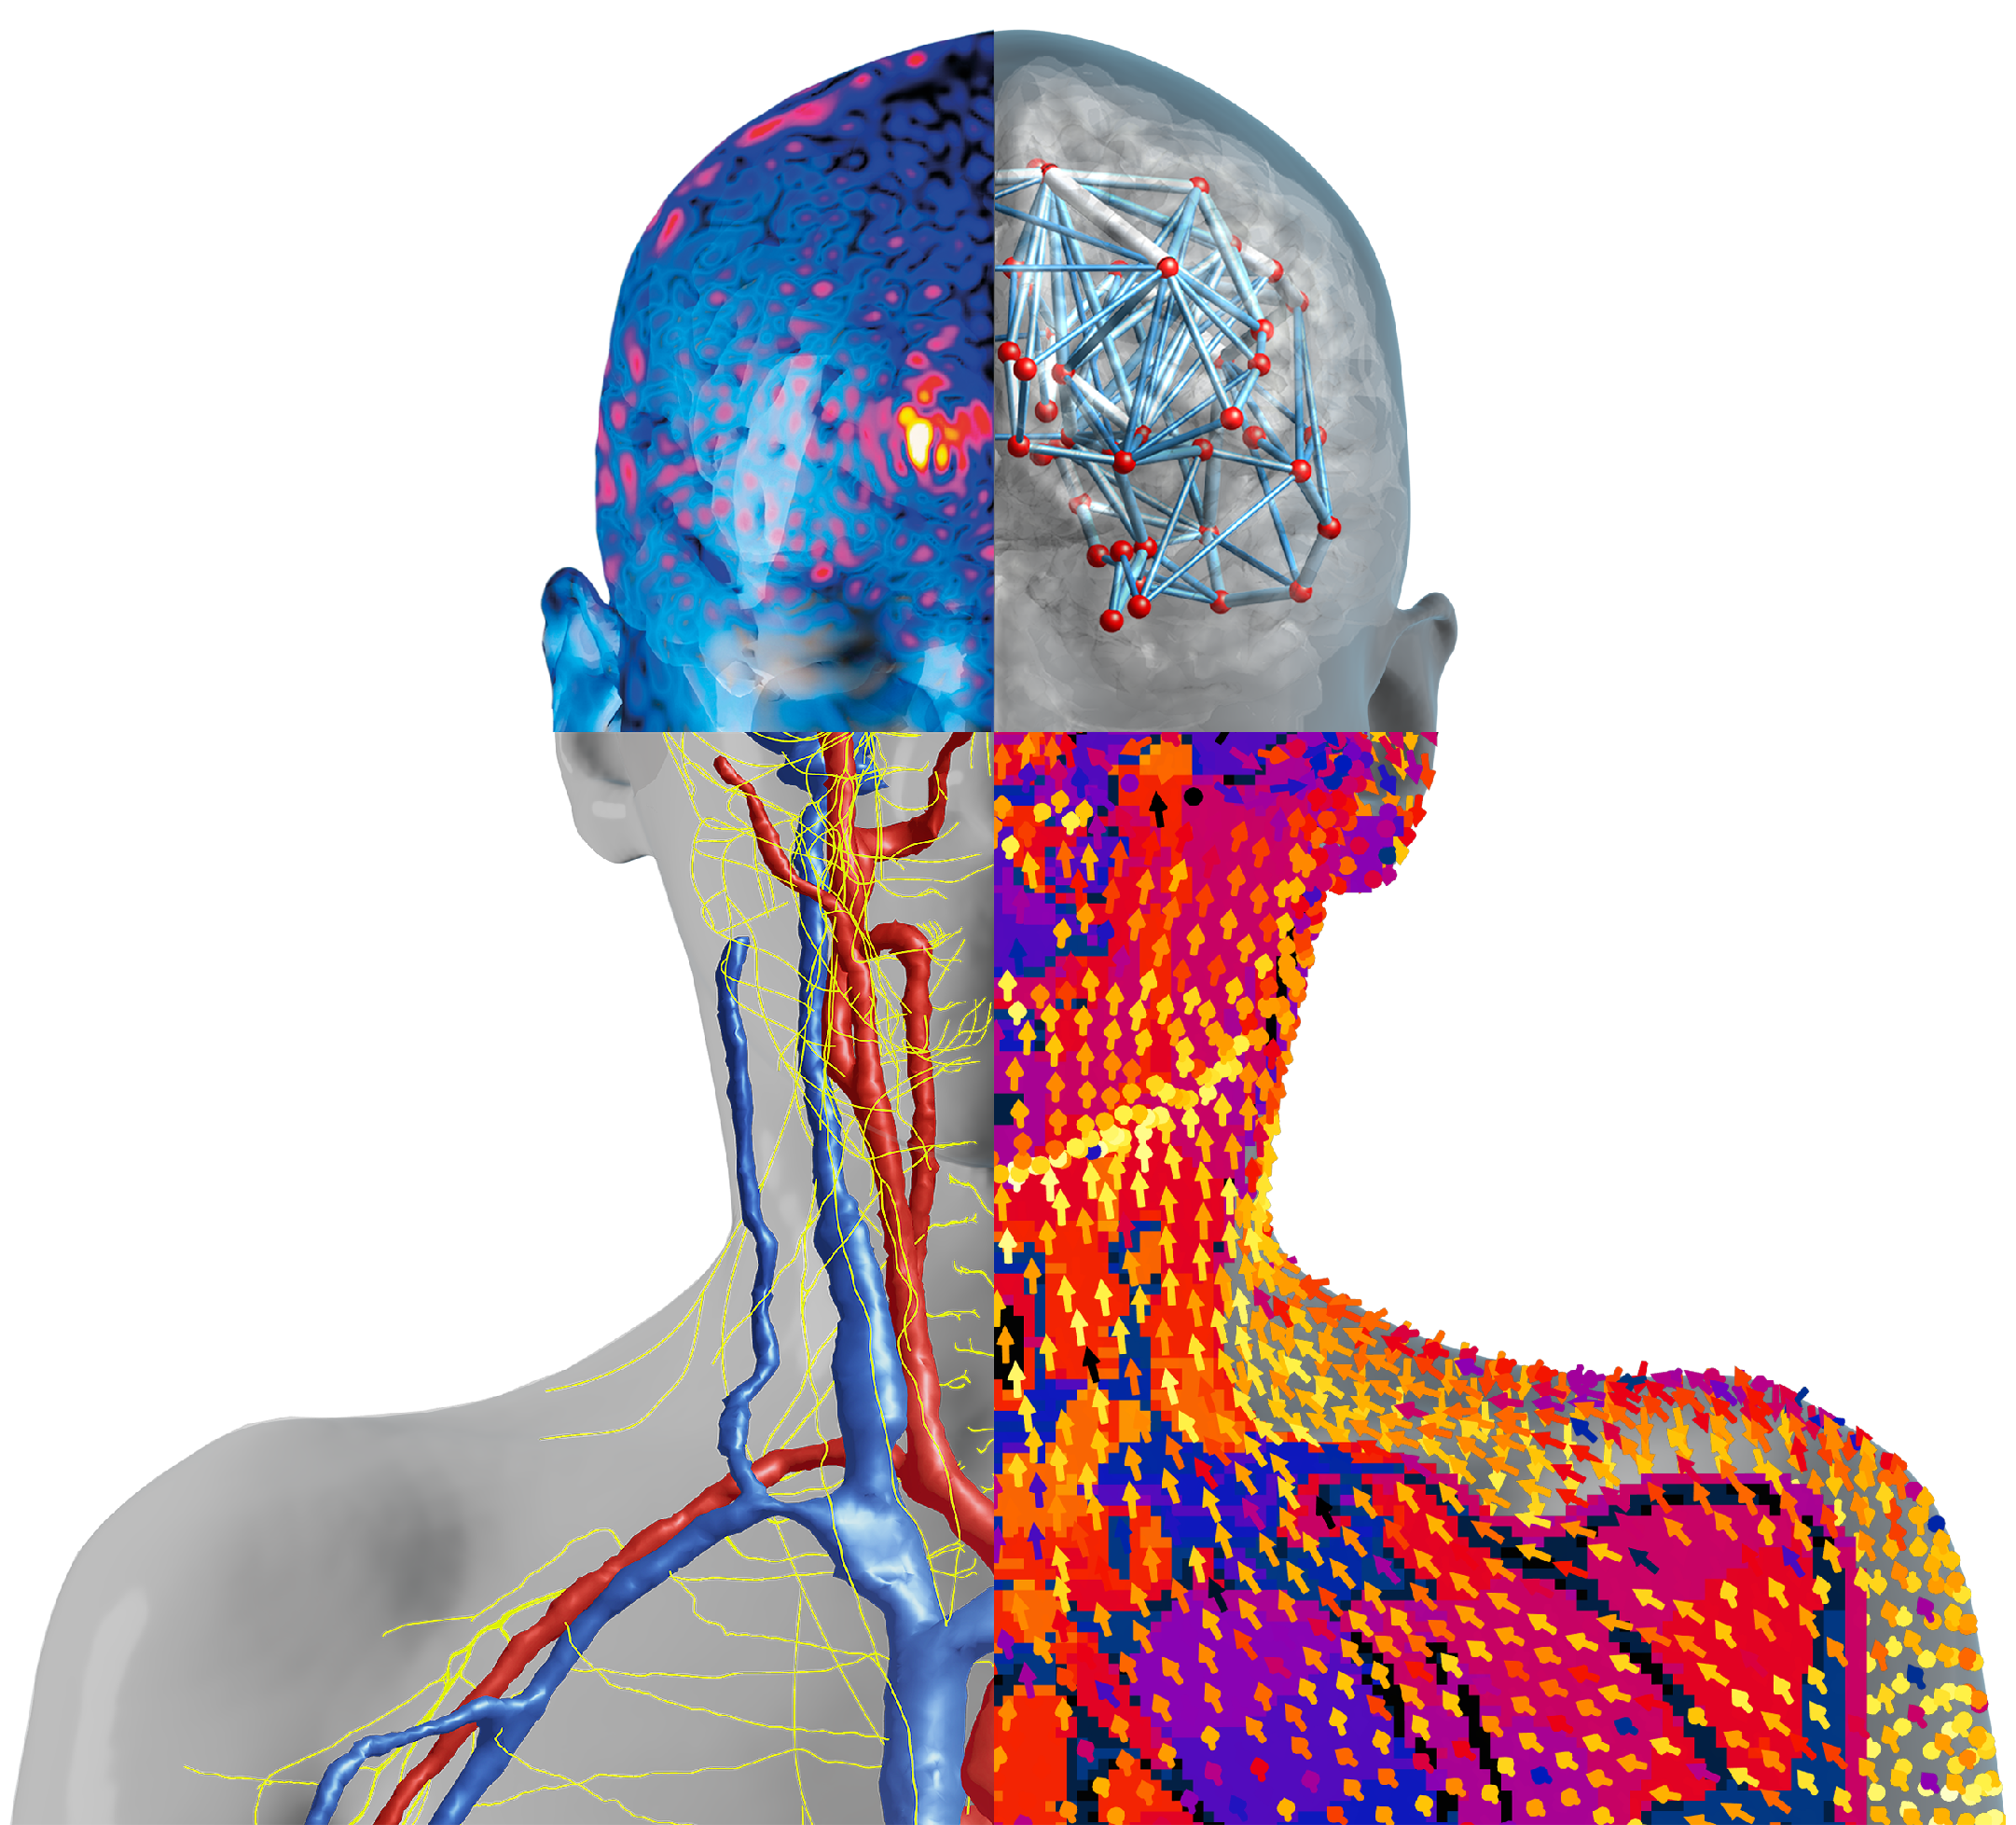


Introducing MetaModeling UX
Javier Garcia Ordonez, IT’IS Foundation & ZMT
Werner van Geit, IT’IS Foundation
Esra Neufeld, IT’IS Foundation

Slide 2

Content
Background & Objectives
Setup & Surrogate Model Building
Example Applications
Next Steps
Conclusions
Introducing the MetaModeling UX, Zürich, 2025

Slide 3
Background & Objectives
Introducing the MetaModeling UX, Zürich, 2025
Introducing the MetaModeling UX, Zürich, 2025
Compliance Evaluations of Inductive WPT, Okinawa, 2024

Slide 4


Background & Objectives
background
strong modeling community & user base
parameter exploration limited by computational & human resources
meta-modeling can leverage cloud-based computing for broad parameter exploration, detection of safety violation conditions, uncertainty quantification…
does not require many more computational resources than classical sensitivity analysis
meta-modeling-specific knowledge & know-how required
objectives
offer users a guided UX (HyperTool) to implement their metamodeling studies
combine their domain-specific modeling knowledge with our meta-modeling know-how
leverage cloud-based computing for high-throughput
insights & analysis added to user studies justifies increased simulation costs
(thus, increased revenues for ZMT & IT’IS)
Introducing the MetaModeling UX, Zürich, 2025
Introducing the MetaModeling UX, Zürich, 2025
Notes:
e.g. people have the modeling knowledge – bring them the meta-modeling UX to plug on top in an intuitive way, and get much more insight, design, etc out of their models. More value for them, using our modeling tools. And many more simulations so we get much more money.

Slide 5
Setup & Surrogate Model Building
Introducing the MetaModeling UX, Zürich, 2025
Introducing the MetaModeling UX, Zürich, 2025
Compliance Evaluations of Inductive WPT, Okinawa, 2024

Slide 6
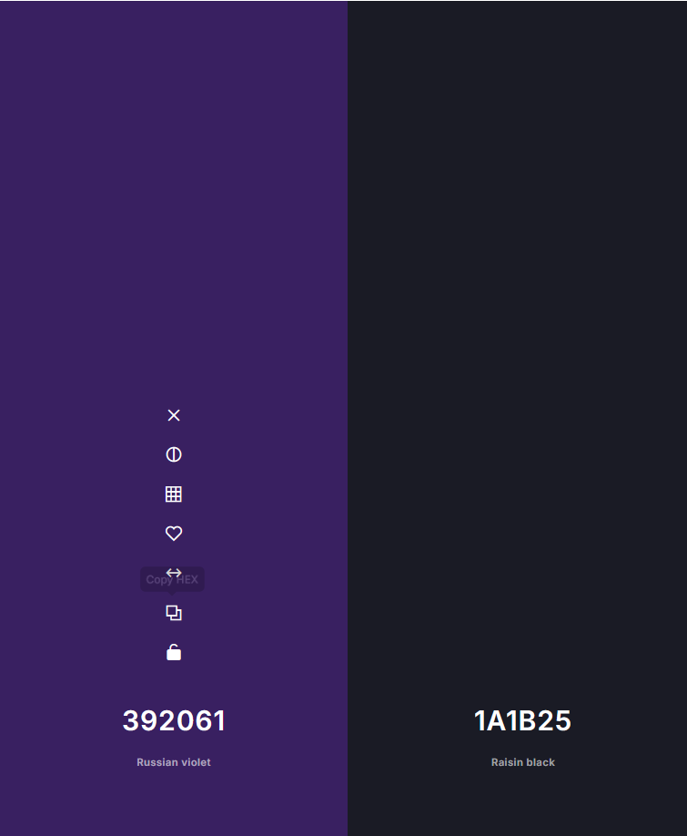
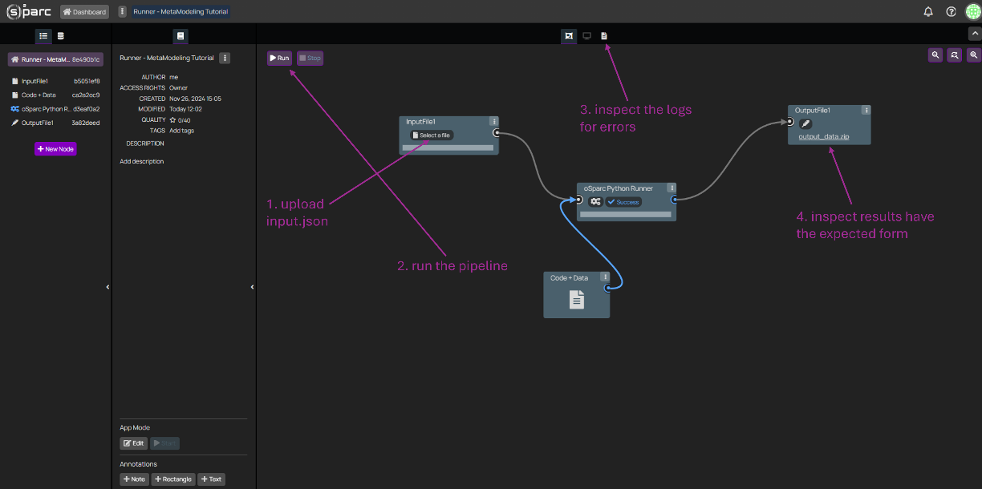





Setup
MetaModeling UX
MetaModeling UX - Setup
Pipeline Setup
Model:
Inputs: Outputs
parameter 1 output 1
parameter 2 output 2
…
Test the model: link-to-instantiated-template
once run, show generated outputs. Otherwise an error symbol, and a link to the logs file.
Introducing the MetaModeling UX, Zürich, 2025

Slide 7

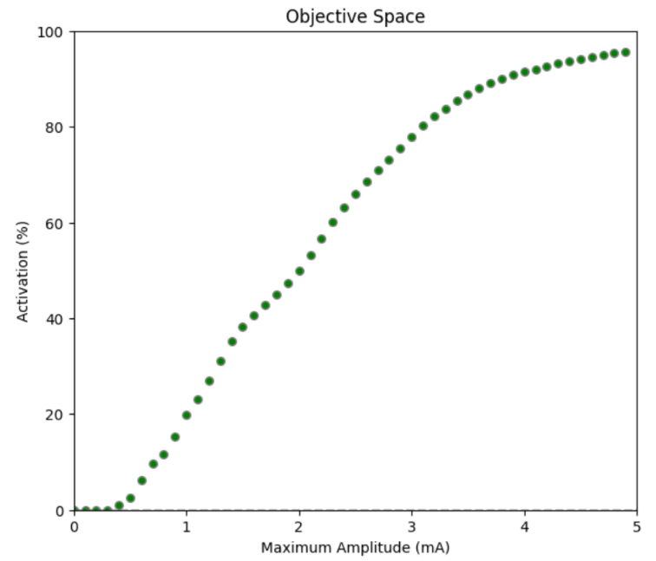
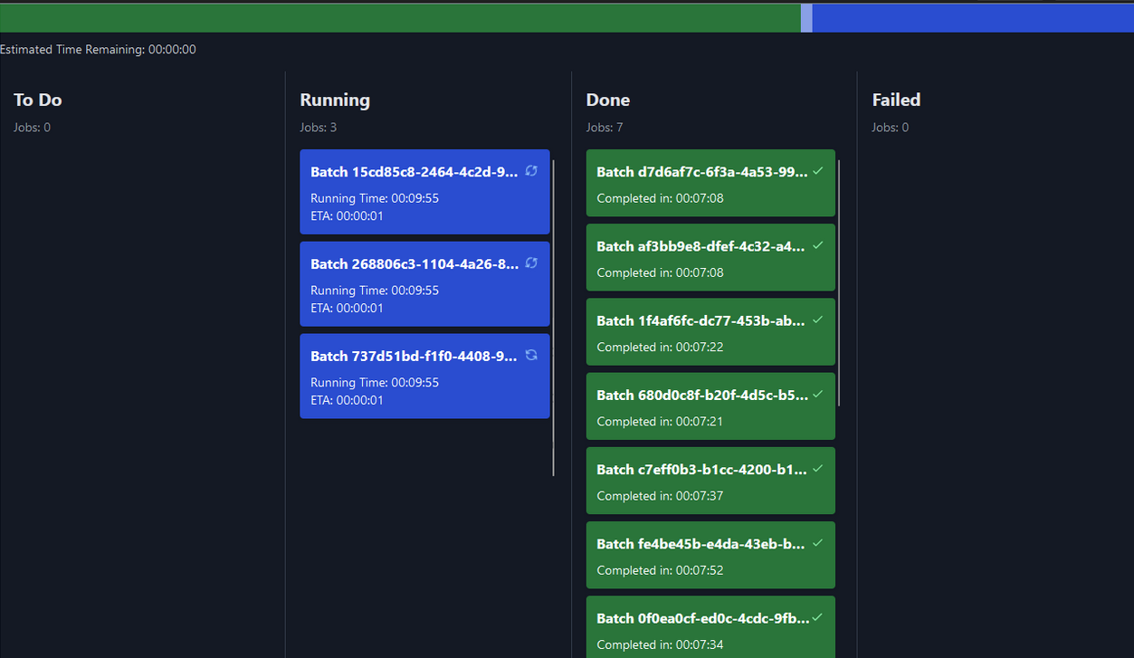
Evaluation
MetaModeling UX
MetaModeling UX - Setup
Pipeline Evaluation
Model:
Parameter sweep:
parameter 1 - Npoints:
parameter 2
…
Run parameter sweep:
similar to S4L, an icon in the bottom right allows to open the “running jobs” interface; and in the future, a view of all jobs in the database (with filters, etc)
Introducing the MetaModeling UX, Zürich, 2025

Slide 8

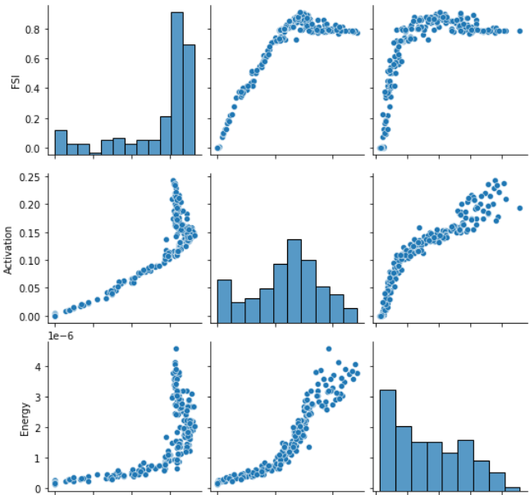




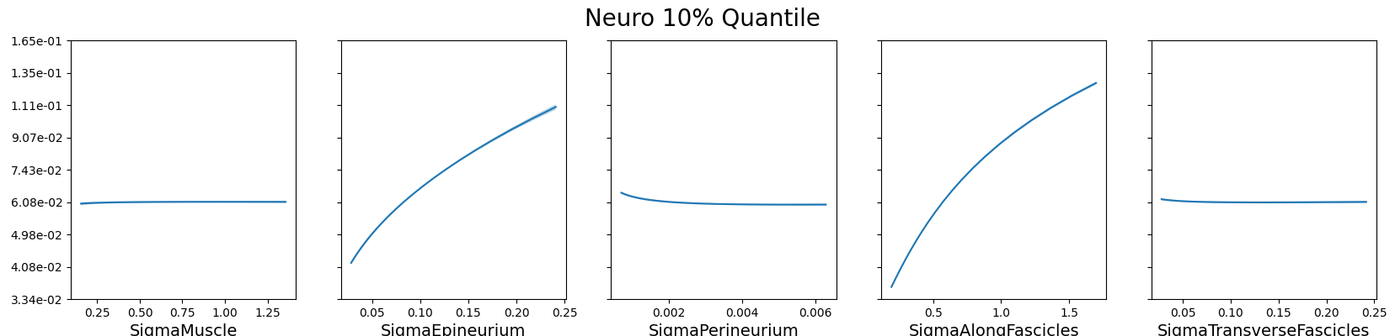
Surrogate Model Building
Surrogate Model Building
Number of Samples to build the SuMo:
Sampling Method: seed:
Surrogate Model:
Output QoI model:
RMSE x.xxx
MAE x.xxx
STD x.xxx
MetaModeling UX
once sampling is complete, a pairplot showing the distribution will be shown, as well as the cross-validation metrics and predictive plots below
Introducing the MetaModeling UX, Zürich, 2025

Slide 9
Example Applications
Introducing the MetaModeling UX, Zürich, 2025
Introducing the MetaModeling UX, Zürich, 2025
Compliance Evaluations of Inductive WPT, Okinawa, 2024

Slide 10



Example Applications: Uncertainty Quantification
MetaModeling UX
Uncertainty Quantification
Number of Samples: seed:
Inputs:
parameter 1 mean: std:
parameter 2 min: max:
…
once sampling is complete, a pairplot showing the distribution will be shown, as well as the cross-validation metrics and predictive plots below
Introducing the MetaModeling UX, Zürich, 2025

Slide 11
Next Steps
Introducing the MetaModeling UX, Zürich, 2025
Introducing the MetaModeling UX, Zürich, 2025
Compliance Evaluations of Inductive WPT, Okinawa, 2024

Slide 12
Next Steps – Choice of UX Tool
requirements
must be deployable within an osparc interactive service (Docker Ubuntu)
offer user interaction (lightweight, responsive)
interactively show code changes (no need to re-deploy service to visualize any changes)
seamless interface with Python code (which will use OSPARC API to launch jobs, retrieve results, etc)
easily maintainable
programmatically testable
programmatic visual formatting (JSON schema like Parallel Runner? -- CHECK)
compatible with version control
options
commonly used front-ends are React.js & Node.js – both JavaScript (would require learning)
Werner’s beautiful Parallel Runner UI is based on React and Vite (both JavaScript)
various Python-only tools are available – however, they tend to be limited for complex UI customizations
Streamlit
Dash (by Plotly)
Gradio
Introducing the MetaModeling UX, Zürich, 2025

Slide 13

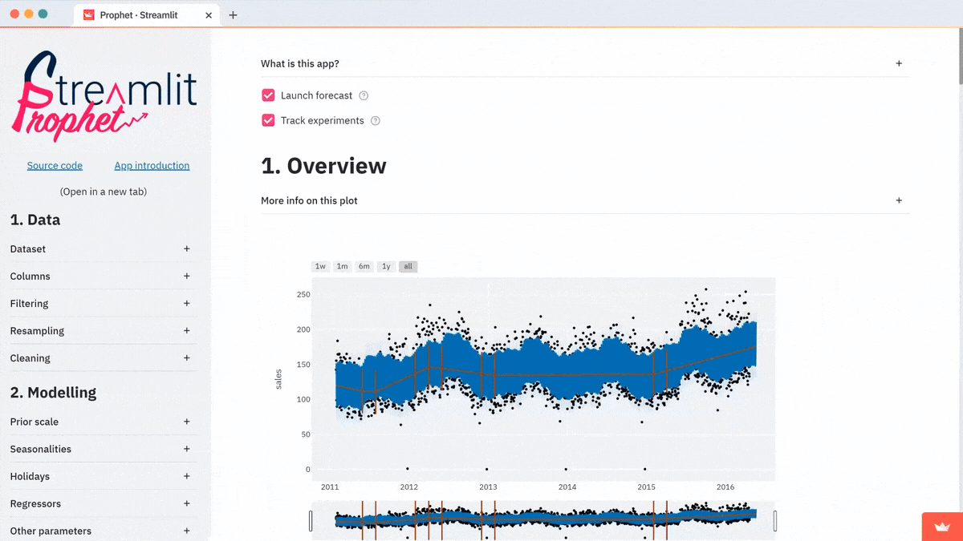
Next Steps – Choice of UX Tool
Streamlit
seems powerful enough
allows dynamic UI changes based on user choices
seems to allow tabs
Introducing the MetaModeling UX, Zürich, 2025

Slide 14

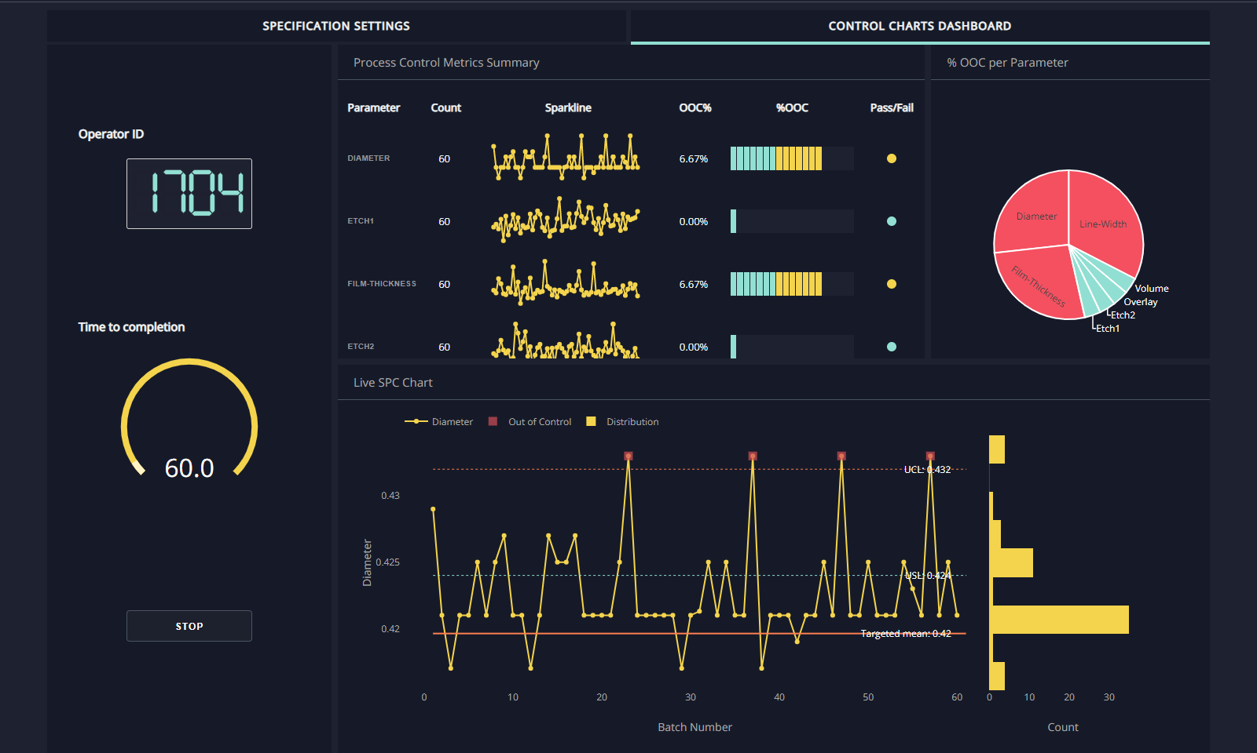
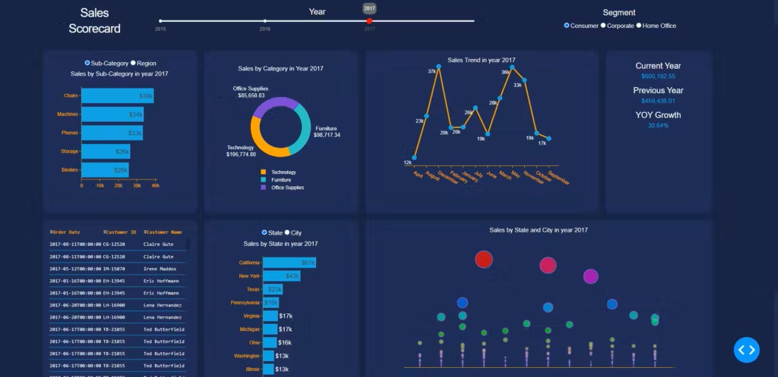
Next Steps – Choice of UX Tool
Dash
seems focused on data analytics dashboard
interactive, dynamically updated plots
however, seems limited to me
dynamic updates of UI through callbacks (slightly more complex)
Introducing the MetaModeling UX, Zürich, 2025

Slide 15

Next Steps – Choice of UX Tool
Gradio
seems focused on interactive UI for machine learning models & data visualization
rapid prototyping; still allows updating UI components based on user choices
however, might be too simple / limited
Introducing the MetaModeling UX, Zürich, 2025

Slide 16
Conclusions
Introducing the MetaModeling UX, Zürich, 2025
Introducing the MetaModeling UX, Zürich, 2025
Compliance Evaluations of Inductive WPT, Okinawa, 2024

Slide 17
Conclusions
metamodeling UX can provide high-value insights & analytics to existing base
enhanced capabilities can support growth of user base
increased computational (simulation) revenues for ZMT & IT’IS
Introducing the MetaModeling UX, Zürich, 2025
Compliance Evaluations of Inductive WPT, Okinawa, 2024

